Slide 1

Project Assignment: Melodica Business Intelligence Pipeline
Anastasia Kyprianou
Christoforos Kagias
Konstantinos Gerogiannis
Nikolaos Gkizelis
Zacharias Walder-Michalas
Project Future 10: Business Intelligence & Data Engineering
Team 6
12/01/2024

Slide 2
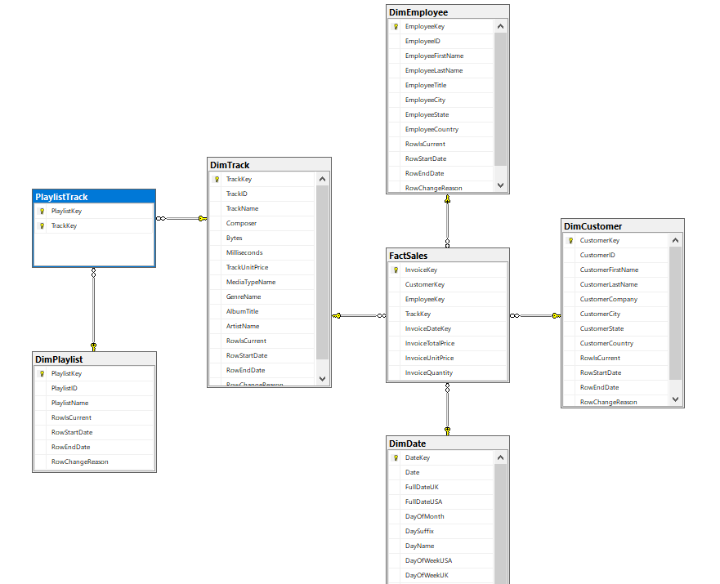
Data Warehouse Snowflake Schema
Fact:
FactSales
Dimensions:
DimEmployee
DimDate
DimCustomer
DimPlaylist
DimTrack

Slide 3
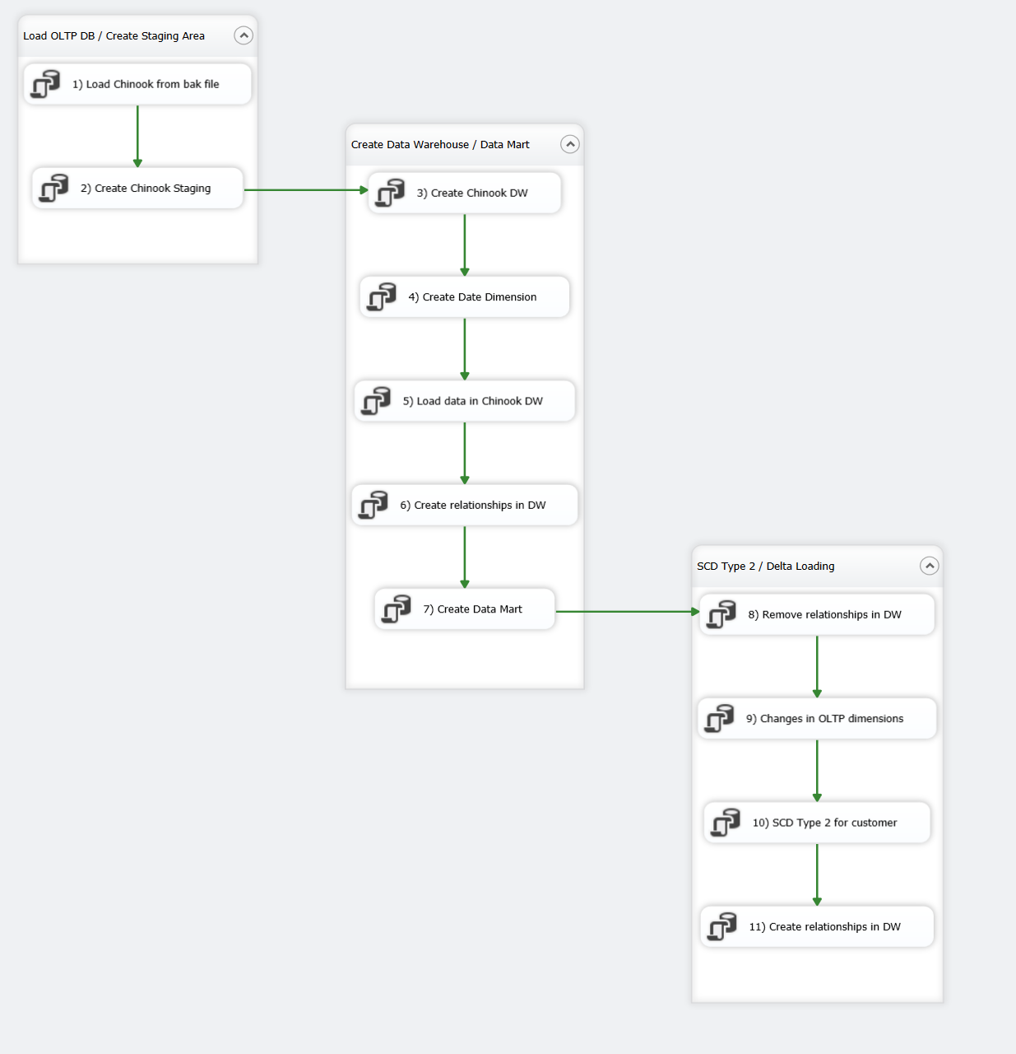
Visual Studio SSIS

Slide 4
SSAS Tabular Model

Slide 5
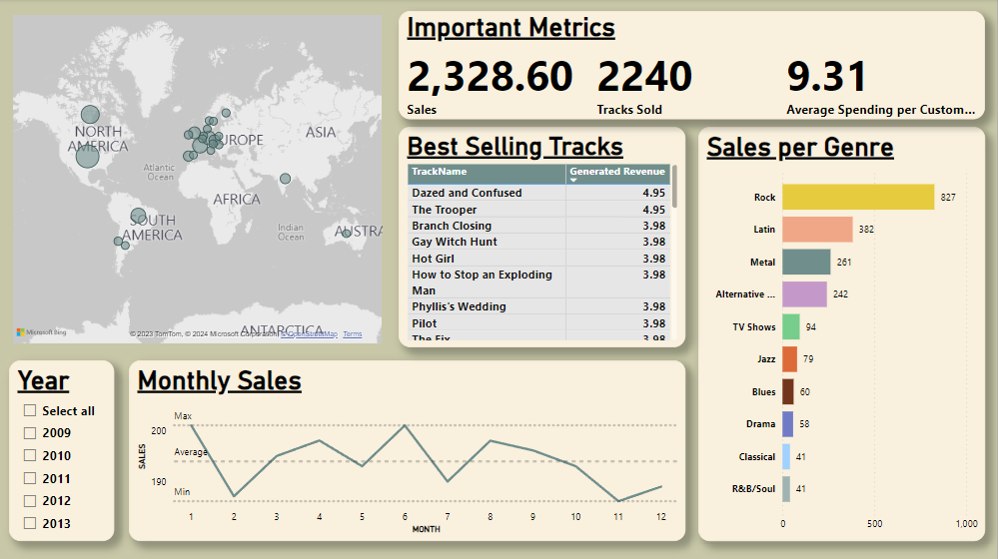
Power BI General Sales Dashboard
Multi-Row Card
Map
Bubble Size: Sales
Track Sales Table
Year Slicer
Stacked Bar Chart
Sales Line Chart

Slide 6
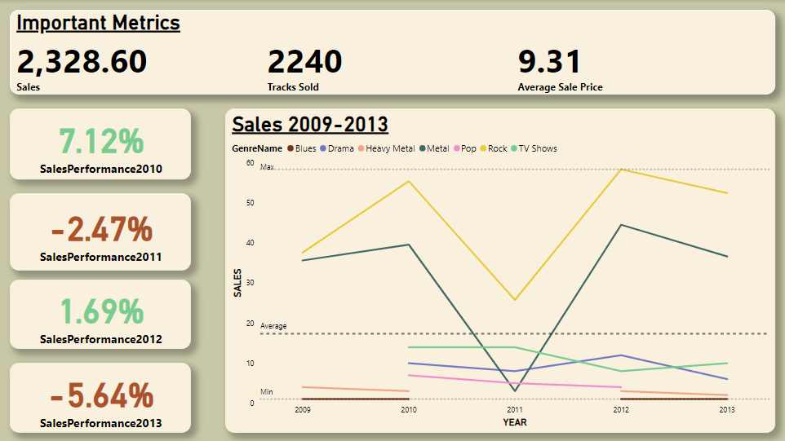
Power BI Genre Long Term Performance Dashboard
ANNUAL SALES PERFORMANCE CARDS
Genre Sales Line Chart
Green: Sales Increase
Red: Sales Decrease

Slide 7
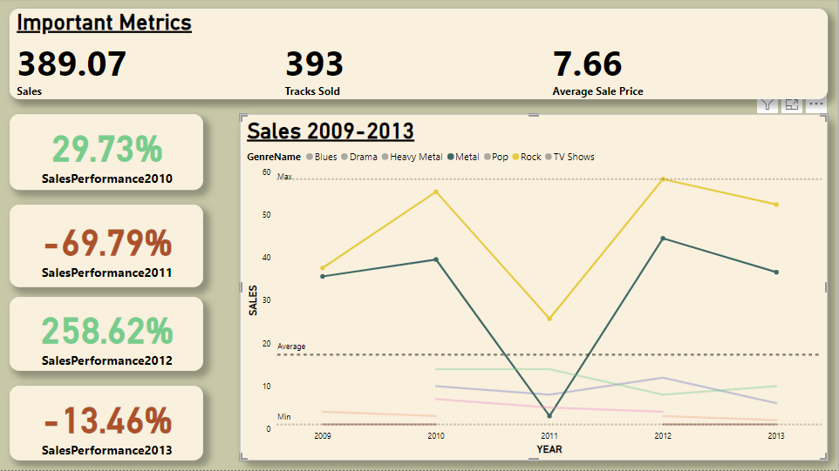
Power BI Genre Long Term Performance Dashboard
The sales progression of Rock and Metal tracks, and their effect on total sales performance

Slide 8
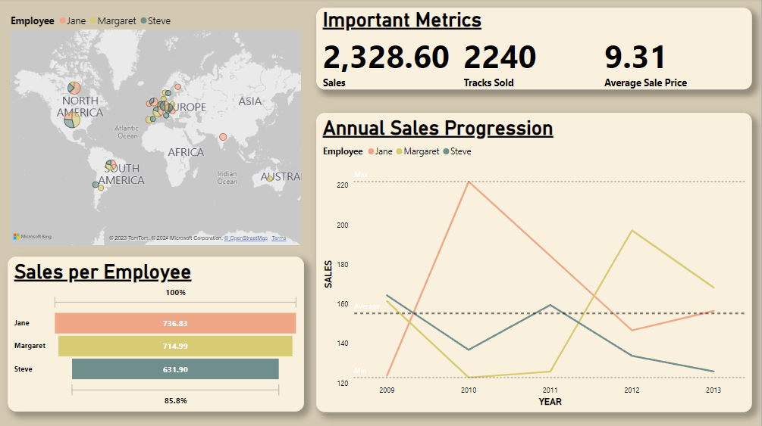
Power BI Employee Long Term Performance
Jane
Margaret
Steve
Funnel Chart

Slide 9
Thank you!
QUESTIONS?

